Slide 1
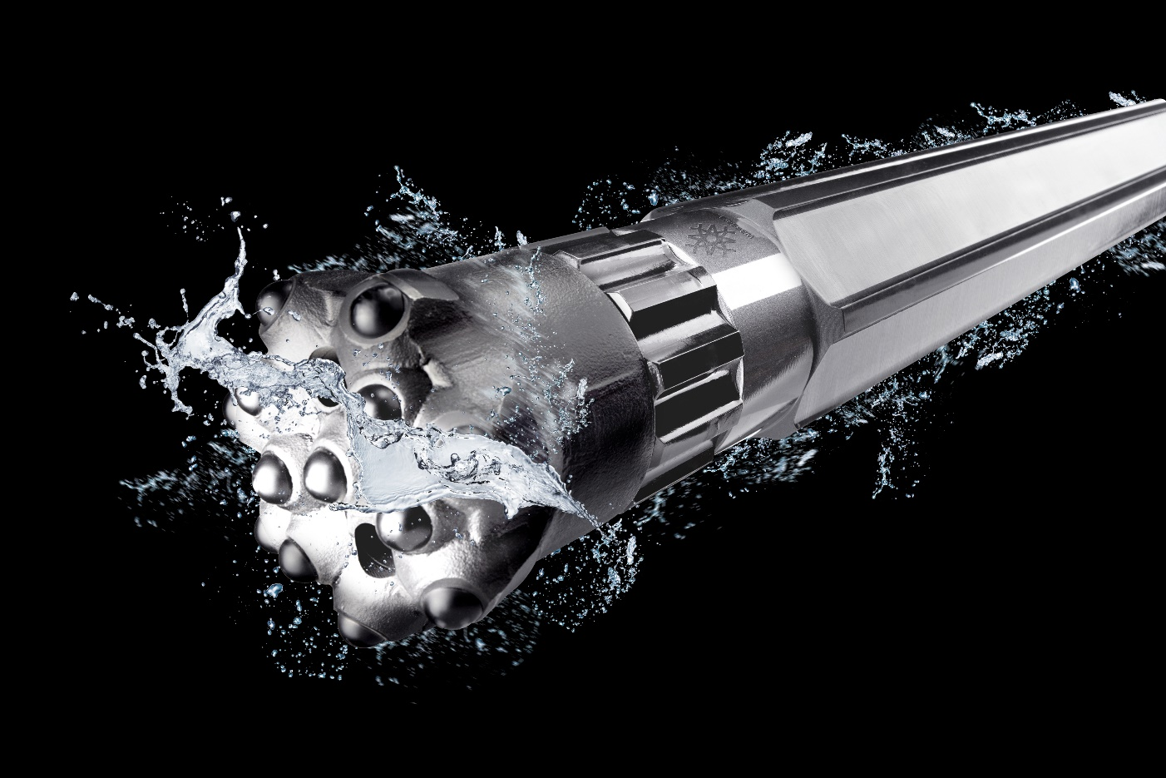
SUSTAINABLE DRILLING Environmentally friendly and energy efficient
2021-06-01
LKAB Wassara

Slide 2
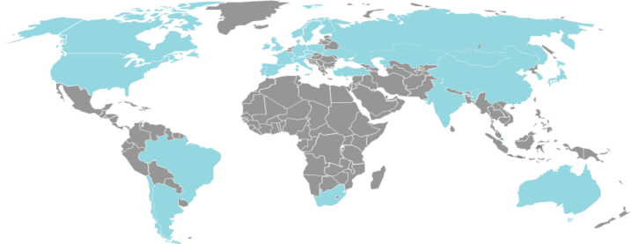
LKAB Wassara
Over 30 years of experience
LKAB Wassara
Part of the LKAB group
60 employees
Sales about 140 MSEK
Headquarters in Stockholm with R&D ,manufacturing and sales
Drilling Technology Center in Malmberget, Sweden
Distributors in 23 countries
Focus; Ground Engineering, Tunnel, Dams, Mining
ISO certified 9001 & 14001
4 300 employees
Sales, BSEK 31,3 (BEUR 3,1)
World leader in underground mining
90% of the EU’s iron ore production

Slide 3
Wassara distributors
All over the world

Slide 4
Some major customers
Using Wassara

Slide 5
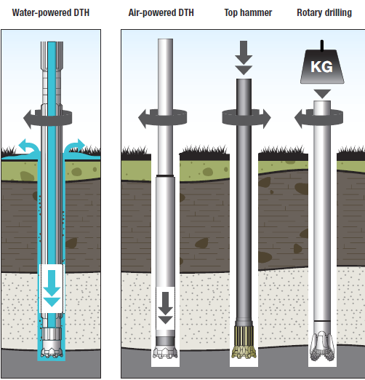
Drilling Technologies
Down-The-Hole, Top-Hammer and Rotary
Key benefits with Wassara:
Low energy consumption
Good working environment
Safer drilling in sensitive areas
Good hole quality
Low noise emission
High Rate of Penetration (ROP)
Straight holes, low deviation

Slide 6
Comparison
Water-powered drilling vs other drilling technologies
 | Hole straightness | Energy consumption | Rate of Penetration Start of hole/End of hole
Water DTH | High | Low | High/High
Air DTH | Medium | High | Very high/Very high (Water in the hole -> Low)
Top hammer | Poor | Low | Extremely high/Low

Slide 7
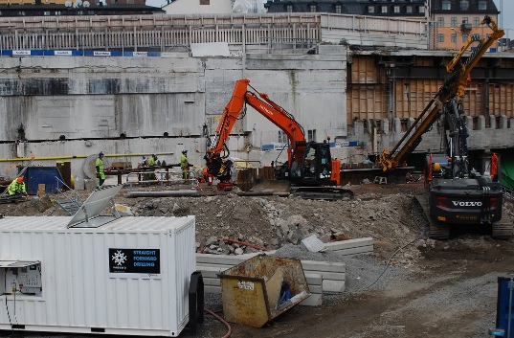
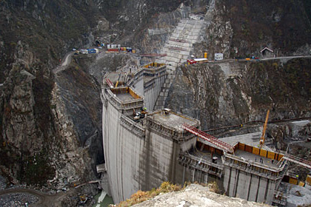
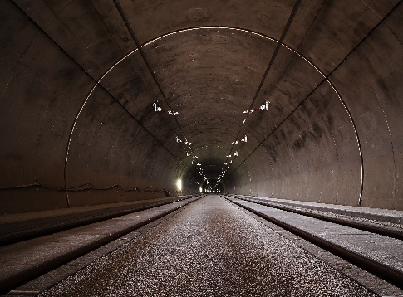
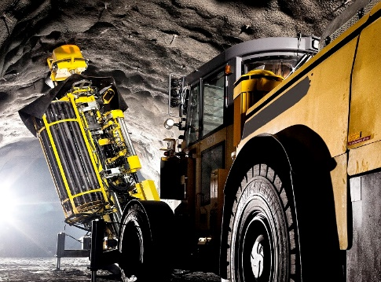
Segments
Our four focus areas
Ground engineering
Dams
Tunneling
Mining

Slide 8
Ground engineering
Key Benefits:
Slussen, Sweden: Pile drilling
Niagara Falls, Canada: Jet grouting
Low risk of damaging surrounding buildings and infrastructure in urban areas.
Low carbon foot print due to low energy consumption.
Water flush gives clean holes which improves grouting results.

Slide 9
Dams
Key Benefits:
Vojmsjön, Sweden: Piling
Angostura dam, Chile: Grouting and drainage drilling
Long straight holes.
High productivity due to high rate of penetration.
Low risk of damaging the surrounding dam structure.

Slide 10
Tunneling
Key Benefits:
Delaware Aqueduct, USA: Exploration drilling - TBM
Söderströmstunnel, Sweden: Anchor drilling
Long straight holes.
High productivity due to high rate of penetration.
Will drill through areas with high water flows and pressures.
Improved working environment with less dust and debris

Slide 11
Mining
Key Benefits:
LKAB mines, Sweden: Blast holes
Mittersill, Austria: Blast holes
Long straight holes.
Will maintain high productivity throughout the entire hole length.
Low carbon foot print due to low energy consumption.
Improved working environment with less dust and debris

Slide 12
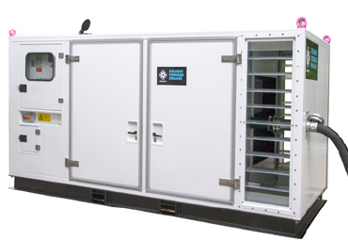
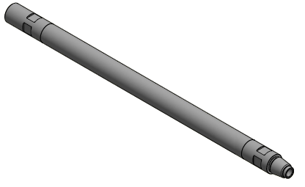
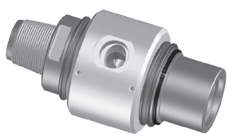
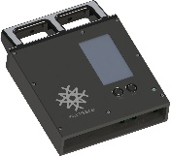
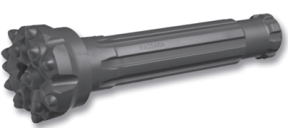
Product Portfolio
Products, systems and services
Wassara DTH-hammer
Drill rod
Drill bit
Swivel
OWD
High Pressure Pump
Surveying system
Hammer service
Technical support
Education

Slide 13
THANK YOU
www.wassara.com

